Slide 1
SMART WASTE MANAGEMENT SYSTEM FOR METRO POLITIAN CITIES
Using Internet Of Things

Slide 2
Introduction
Today huge towns round the sector are going through a not un usualplace problem, dealing with the metropolis waste efficaciously with out making metropolis unclean.
Today`s waste control structures contain a big variety of personnel being appointed to wait a positive variety of dumpsters that is finished each day periodically.
This ends in a completely inefficient and unclean machine wherein a few dumpsters could be overflowing a few dumpsters won't be even 1/2 of full.
This is resulting from version in populace density with inside the metropolis or a few different random aspect this makes it not possible to decide which component desires instant attention.
Here a waste control machine is added wherein every dumpster is embedded in a tracking machine in an effort to notify the corresponding private if the dumpster is full.
In this machine, it's also feasible to split moist and dry waste into separate containers. This machine presents an powerful technique to the waste control problem

Slide 3
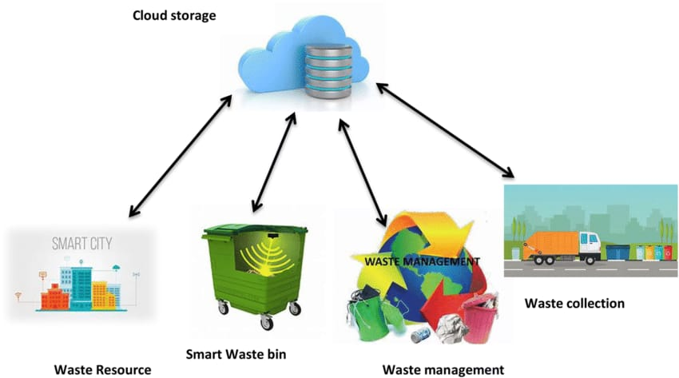
IOT based waste management system

